Slide 1



VoLancia Balancing the orb voices

Slide 2
Meet Our Team
ANSH
MITTAL
SMARTH ARORA
ASHWINI KUMAR SINGH
AMAN SINGH

Slide 3
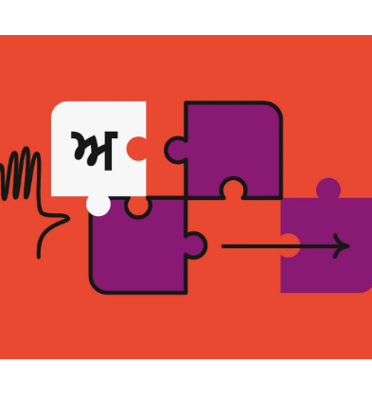
Problem Statement-3
The goal is to develop a language translator tool tailored for government organizations, providing the capability to translate English content into a specific language. This tool is designed to enhance accessibility and usability for a wider audience. The key focus is on creating a language translator for official government websites, eliminating language barriers and ensuring effective communication…
3

Slide 4
Gotta aim to convert all the languages into one single mother Tongue that unfortunately turns out to be ENGLISH or anything else you may aspire for…
Extension for Novices
History for GeeKs
Auto Language detecT
Accessible on more than 200 languages.
Modify history if you don’t like it.

Slide 5
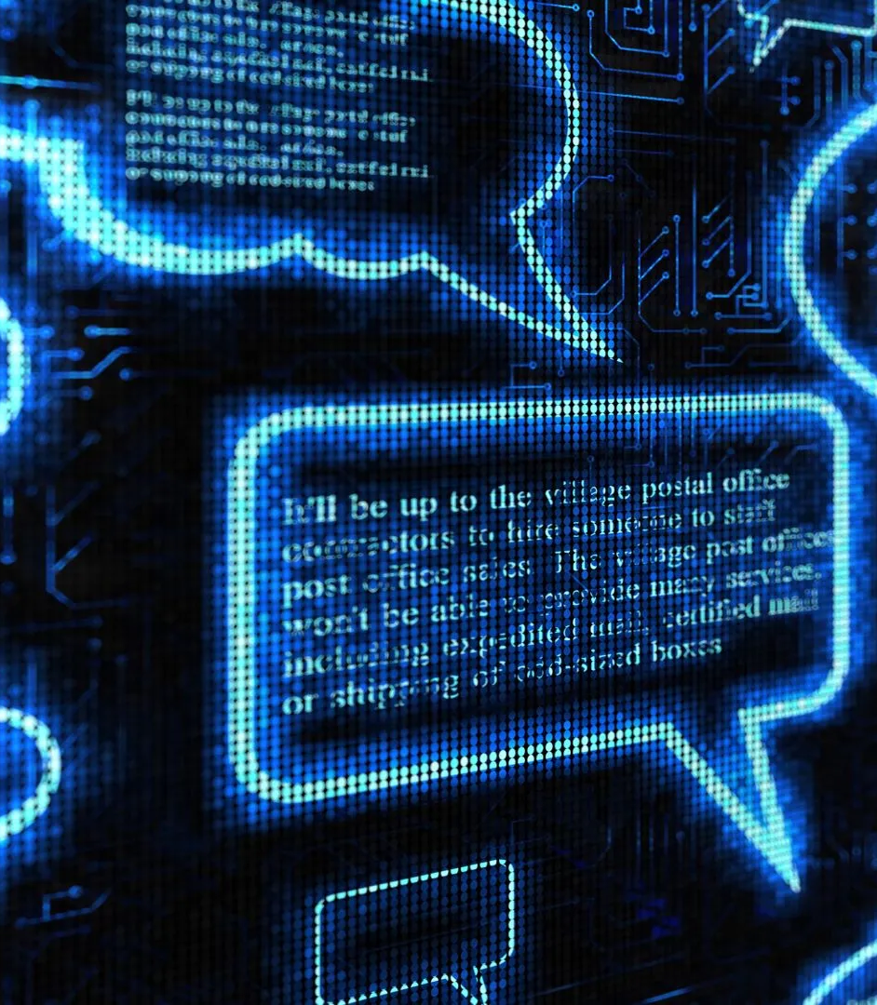
*Provides feasible solution for all languages in one go. *Saves all responses for geeky nerds. *Detecting all text for all.
Objectives

Slide 6
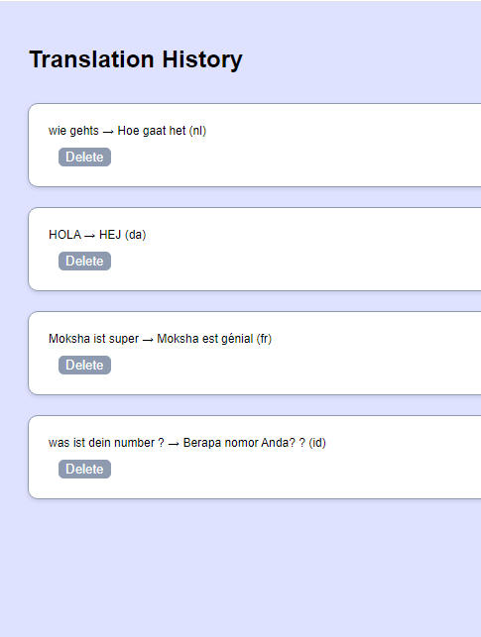
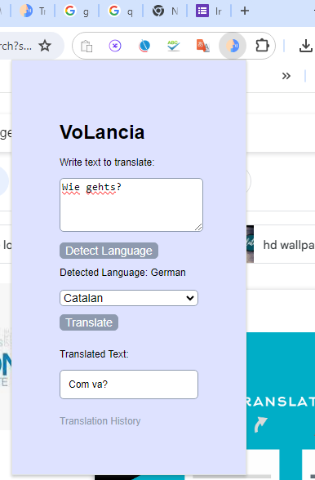
How things look likE;)
6

Slide 7


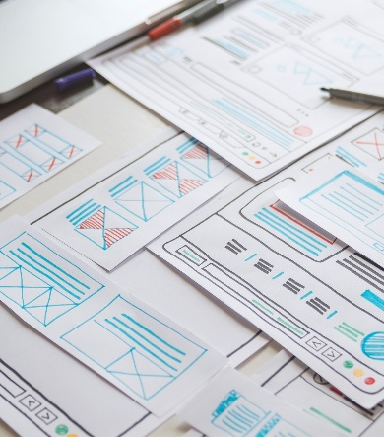
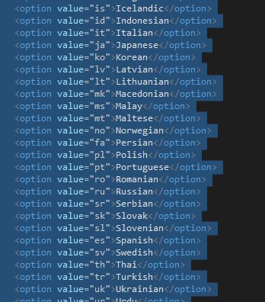

Plan ON THE Goals
Ideation
Prototyping
Design
And so the code goesss
ReaDy to Go

Slide 8
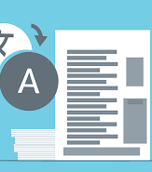
Technologies UseD
HTML
CSS
JavaScript
Azure AI Translate API
Azure Language Detection API
8

Slide 9
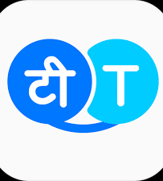
Summary
With this venture of ours, we aim to personify all the local dialects which aim to focus on innovation and share our vision.
Using it as an extension will enable user to effectively navigate for a particular text without leaving the site.
Surety guaranteed for the results.
9

Slide 10
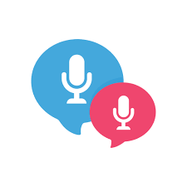


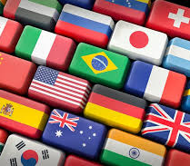
Thank you

